Slide 1
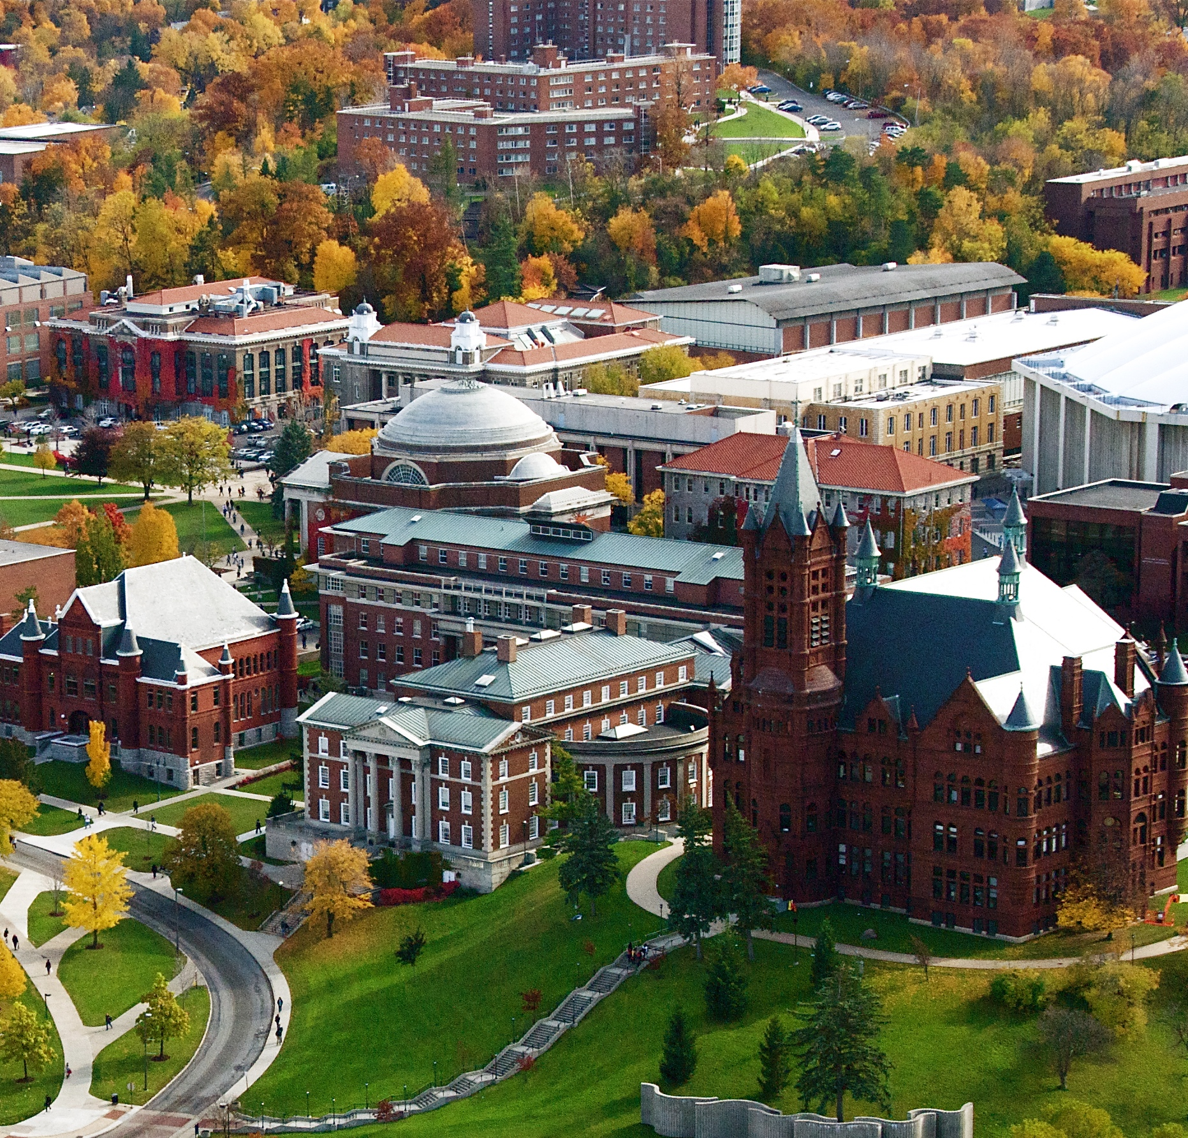

MACNY & Green Energy in CNY
November 2023
Will Breitenbach, Luke Boyer
Jay Shankar, Darci Johal

Slide 2
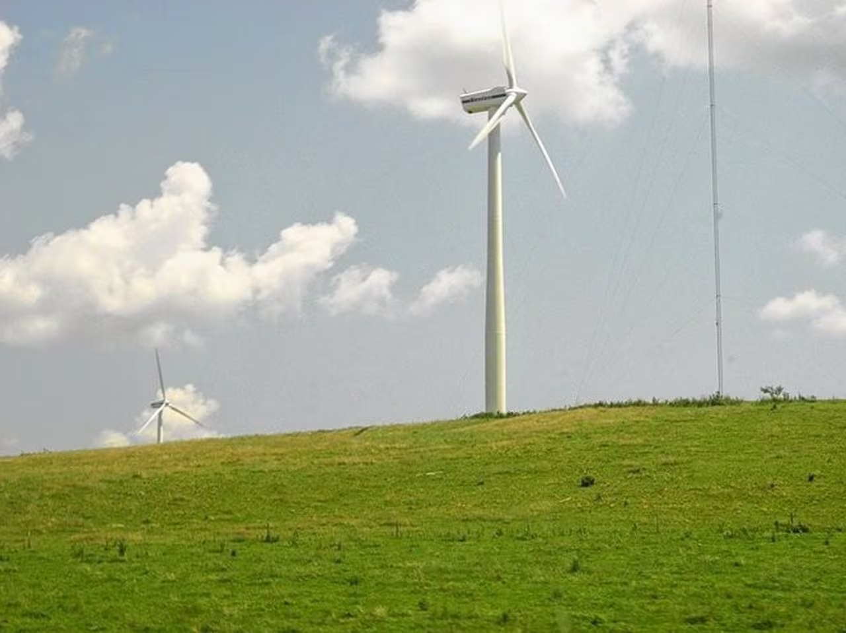
Agenda
Who is MACNY?
Survey Data
Recommendation to MACNY
Local Leaders in Sustainability
CNY Green Energy Projects
Conclusion

Slide 3
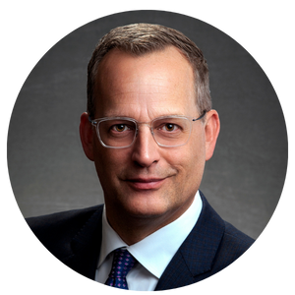
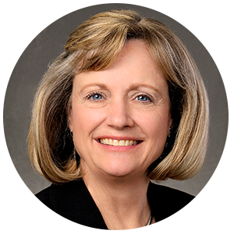

Who is MACNY?
Manufacturers Association of Central NY
300+ Member Companies
Offer Training, Networking Events, Energy Solutions, Workforce Development
Non-Profit 501(c)(6)
Focus on Climate Leadership and Community Protection Action (2019)
Matt Geitner Director of Government Relations
Cindy Oehmigen Director, Energy & Corporate Services

Slide 4
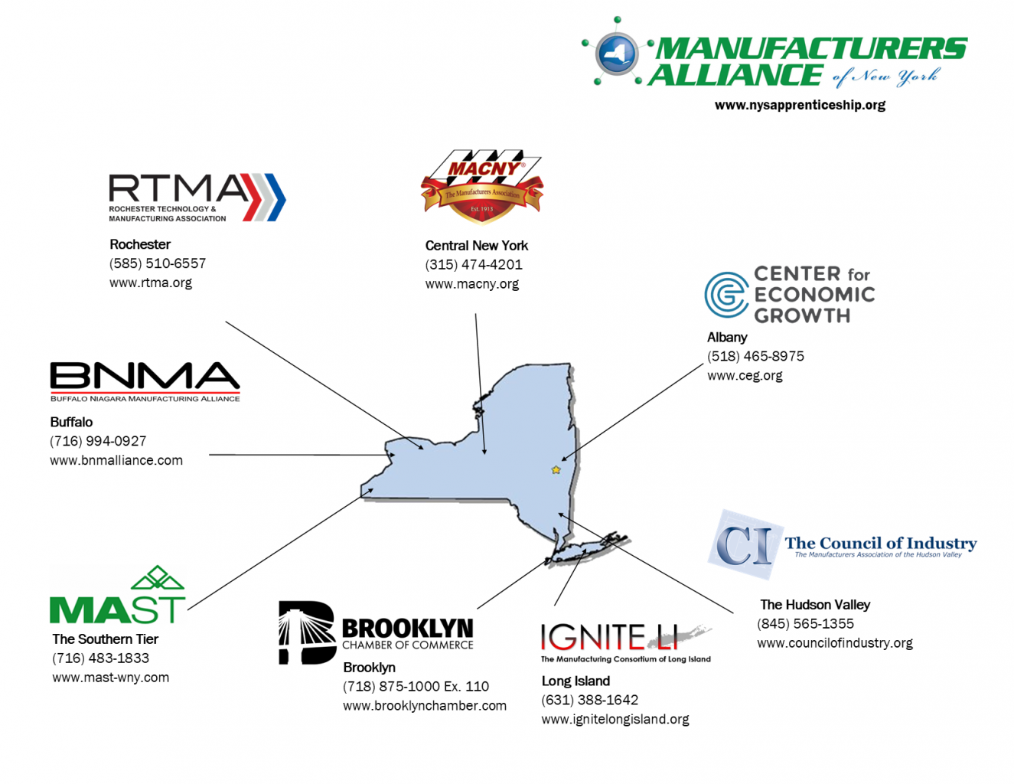
Who is MACNY?
Partnership with other regional Manufacturing Associations
5,400 total manufacturing and manufacturing support member companies

Slide 5

Survey Data

Slide 6











Survey Data
Survey sent October 13th – 165 companies
Hesitancy, Confidentiality, Accuracy
23 Total Questions
NAICS Codes
Printing/Paper, Dairy, Steel, Machine Shops
1. Electricity 2. Natural Gas 3. Petroleum

Slide 7


Survey Data
Manufacturing Energy Usage
Non-Manufacturing Energy Usage
Average: 49,140,937 kWh
Max: 280,000,000 kWh
Min: 80,000 kWh
Average Annual Cost: $6,079,074
Average: 10,372,340 kWh
Max: 40,000,000 kWh
Min: 60,000 kWh
Average Annual Cost:
$722,218

Slide 8
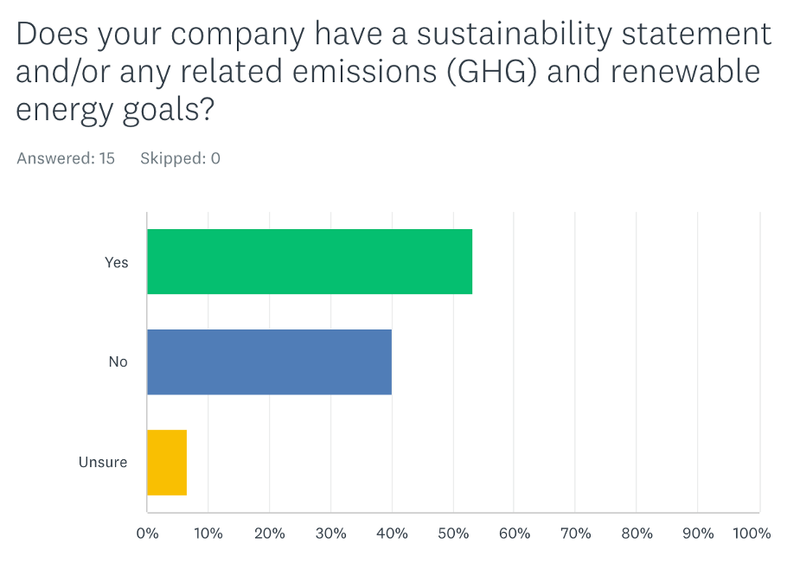
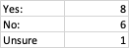
Survey Data
Approaches range from improving energy efficiency of owned equipment, improving workflow and processes, purchasing green energy from a supplier, and reduction of waste

Slide 9
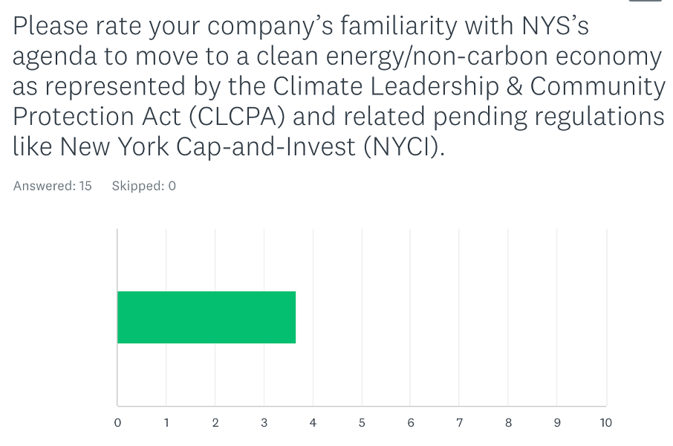
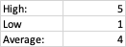
Survey Data
Companies may not have complete understanding of New York State’s agenda to move to clean energy in the manufacturing industry.

Slide 10

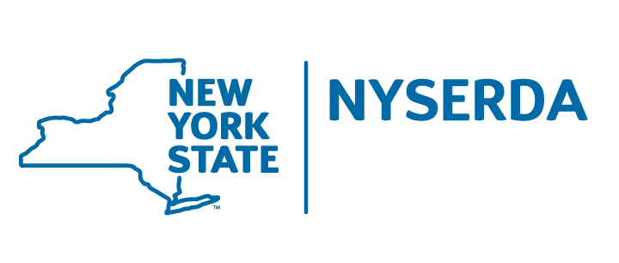
MACNY Newsletter Recommendation
Continue Outreach – Manufacturer’s Energy Group (MEG)
Work with NY State Government on Education
Become an Industry Leader
New York Cap and Invest (NYCI)
Affordability
Climate Leadership
Investing in Disadvantaged Communities

Slide 11
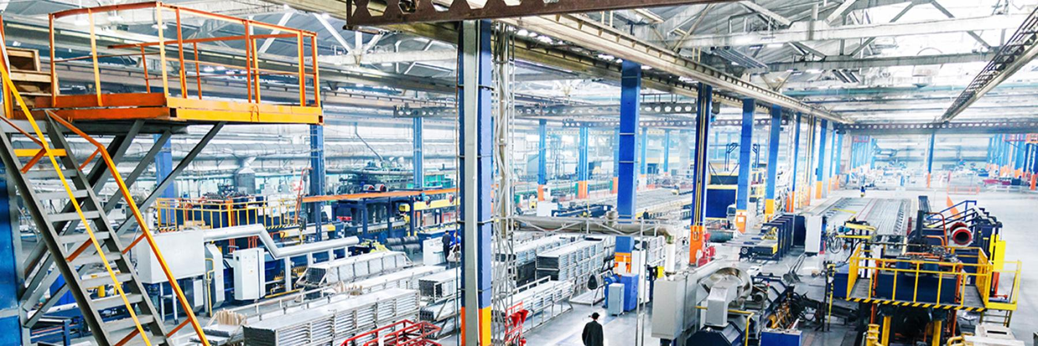
Local Leaders

Slide 12

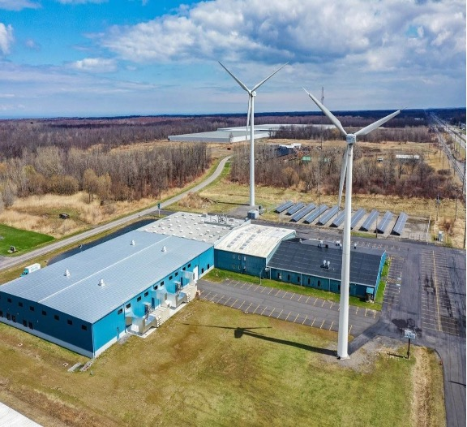
Harbec - Ontario, NY
60% of energy from on-site wind turbines and solar panels
Repurposes heat energy with AC system
Water-Neutral
NYSERDA Grant – 8 wind turbines with a combined capacity of 820 kW

Slide 13

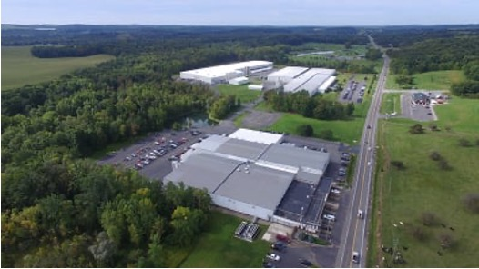
Tessy Plastics – Skaneateles, NY
37,931 mWh generated in 2022 from Wind & Hydropower purchasing agreements
86% Waste recycling or reclamation
Close looped water-cooling systems
Use of sustainable packaging

Slide 14

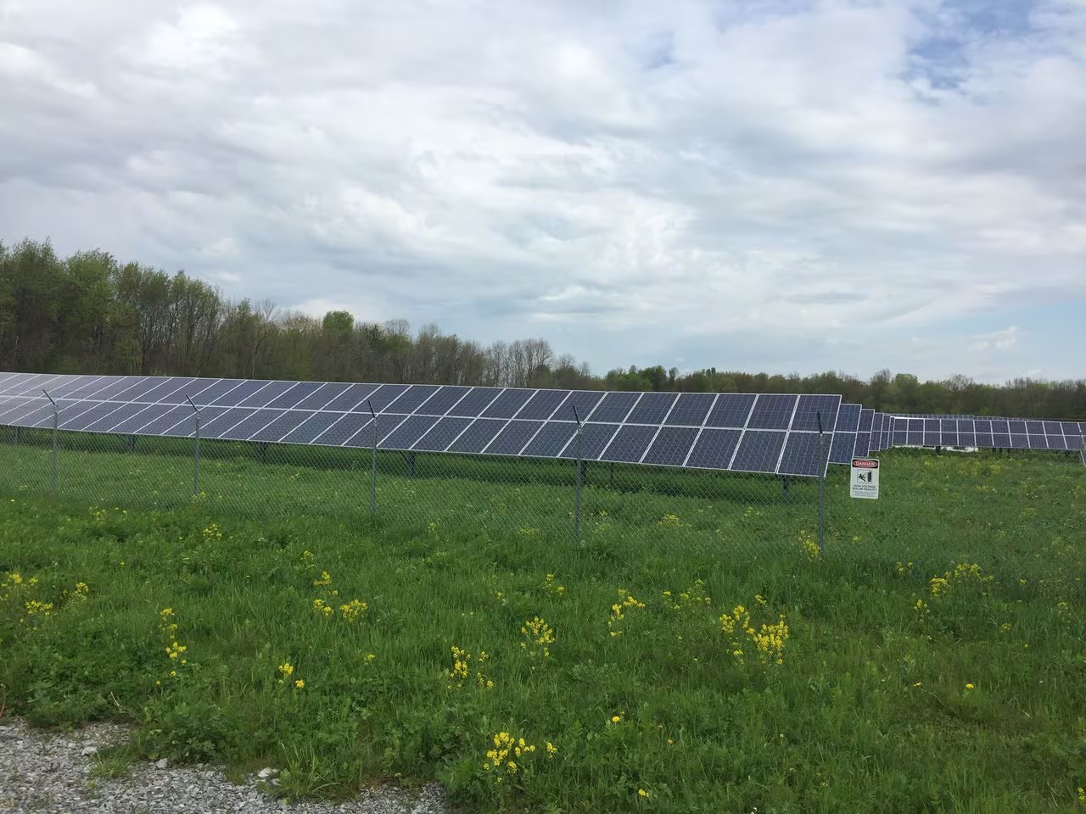
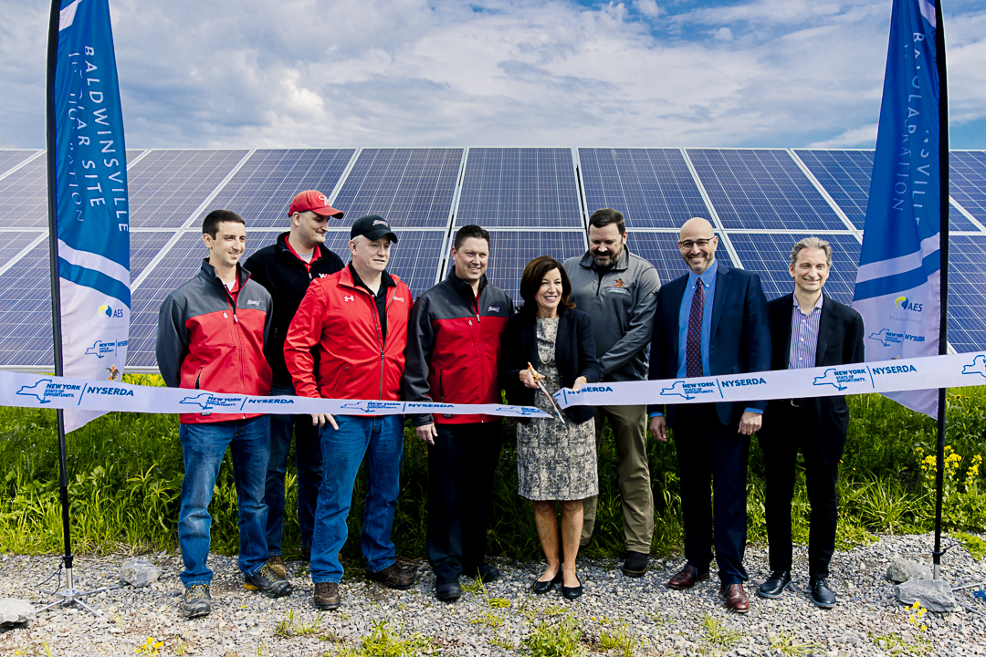
Anheuser-Busch – Baldwinsville, NY
8,000 panel installation in Van Buren, NY
3 million kWh annually on 18 acres
Produces 3 million cases per year from power generation

Slide 15

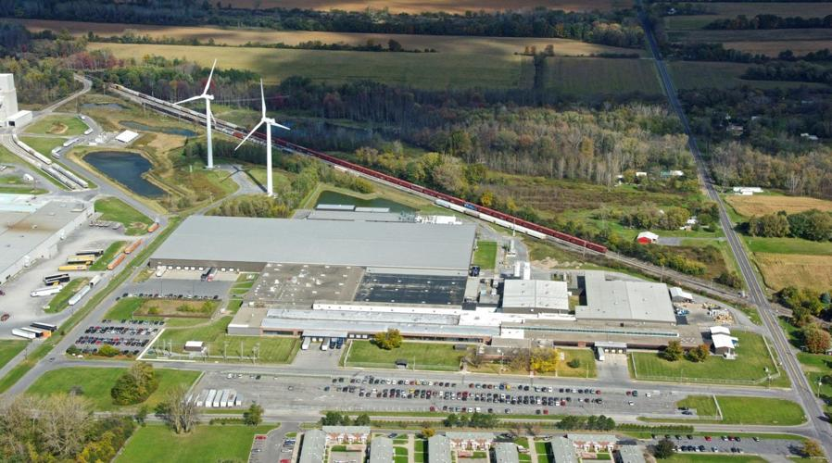
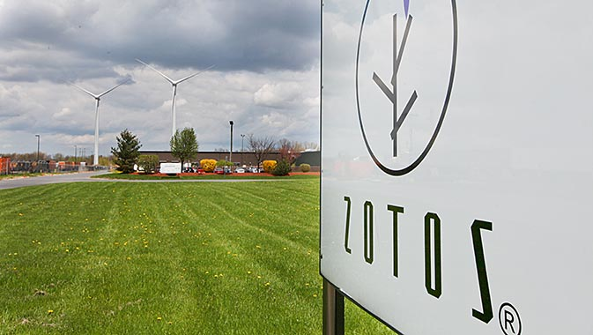
Henkel – Geneva, NY
Operates two 1.6MW windmills
Powers 20 percent of facility with periodic increases
Facility produces soaps and hand sanitizer

Slide 16
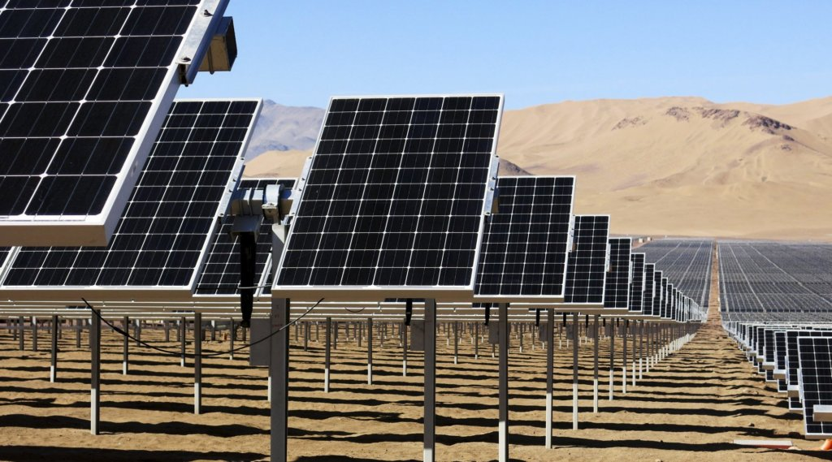

CNY Green Energy Projects

Slide 17
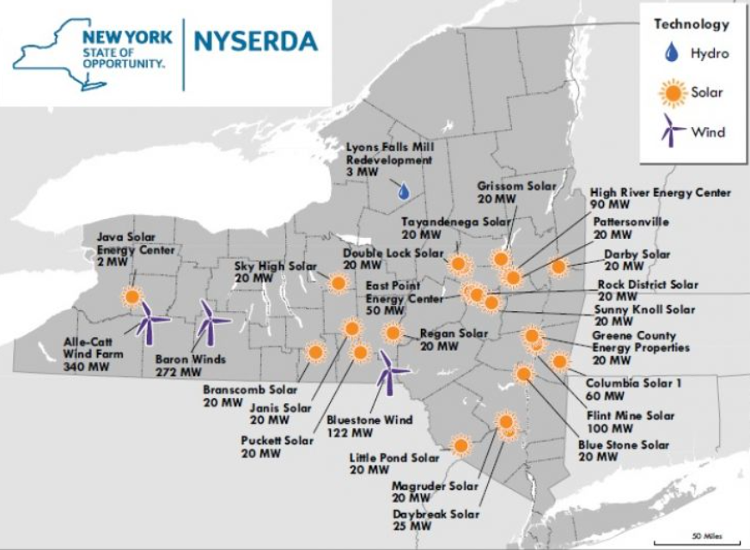
Central NY Solar & Wind Development
Signing Climate Leadership Community Protection Act in 2019 sparked need to get 70% renewable energy production by 2030
Large amounts of vacant rural land for solar/wind development
NY Gov. made $1.4B commitment to advance 22 wind projects across the state in 2018

Slide 18
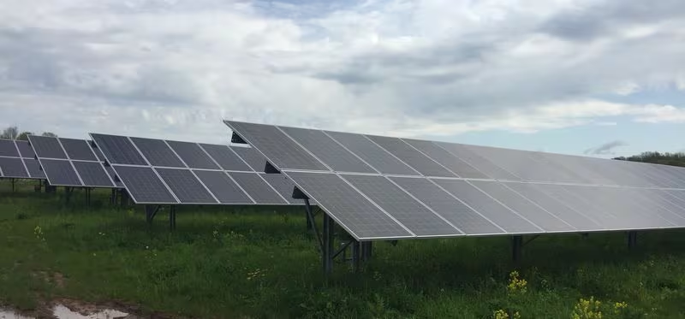

DeWitt Solar Farm
7,700 Solar panels producing 2.66 megawatts annually
Built and operated by RER Energy
Electricity goes to national grid with DeWitt receiving credit on utility cost
Over 20 years, Dewitt will save 2 million on municipal energy costs

Slide 19
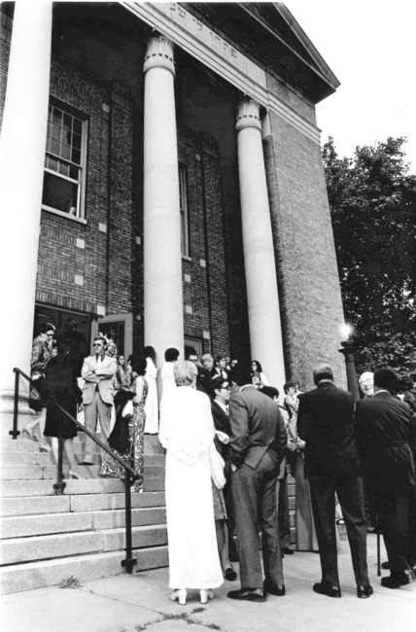
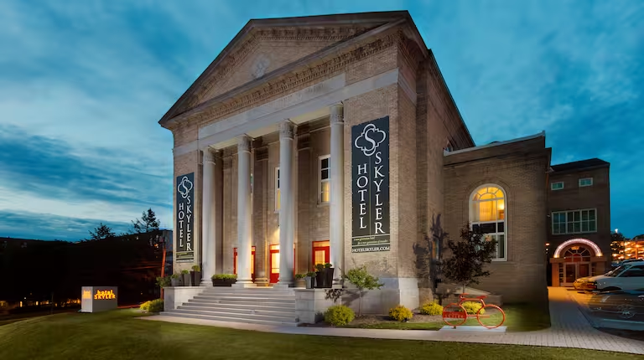
Hotel Skylar - Geothermal
16 vertical wells with 68 water to air heat pumps
LEED Platinum Certification
Key card energy management System

Slide 20

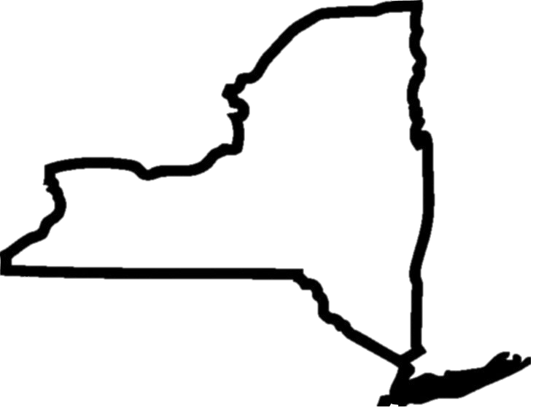

Conclusion
MACNY should continue accepting survey results to better understand their members’ energy needs
NY State’s CLCPA and Cap-and-Invest legislature can benefit manufacturers in the state and allow companies to become industry leaders
MACNY can use local leaders in clean energy as a resource to educate their members on benefits of renewable energy uses

Slide 21
Thank You!
November 2023
Will Breitenbach, Luke Boyer
Jay Shankar, Darci Johal

Slide 22
https://www.syracuse.com/drinks/2019/05/new-solar-array-helps-power-anheuser-buschs-big-cny-brewery.html https://capandinvest.ny.gov/ https://www.syracuse.com/business/2020/05/why-is-cloudy-syracuse-suddenly-a-solar-farm-magnet.html https://www.macny.org/wp-content/uploads/2023/10/Manufacturing-Matters-Newsletter-Nov-2023.pdf https://www.fltimes.com/business/new-name-more-jobs-for-plant-formerly-known-as-zotos/article_58c7f034-a23f-58e3-a84f-07aa57f36874.html https://www.greenbiz.com/article/syracuses-hotel-skyler-becomes-third-leed-platinum-hotel https://www.macny.org/ Novelis-Sustainability-Report-2023.pdf https://tessy.com/wp-content/uploads/2023/07/Tessy-2023-Sustainability-Report-V2.pdf https://www.plasticsmachinerymanufacturing.com/features/article/21136683/harbec-succeeds-in-carbonneutral-quest

